Slide 1
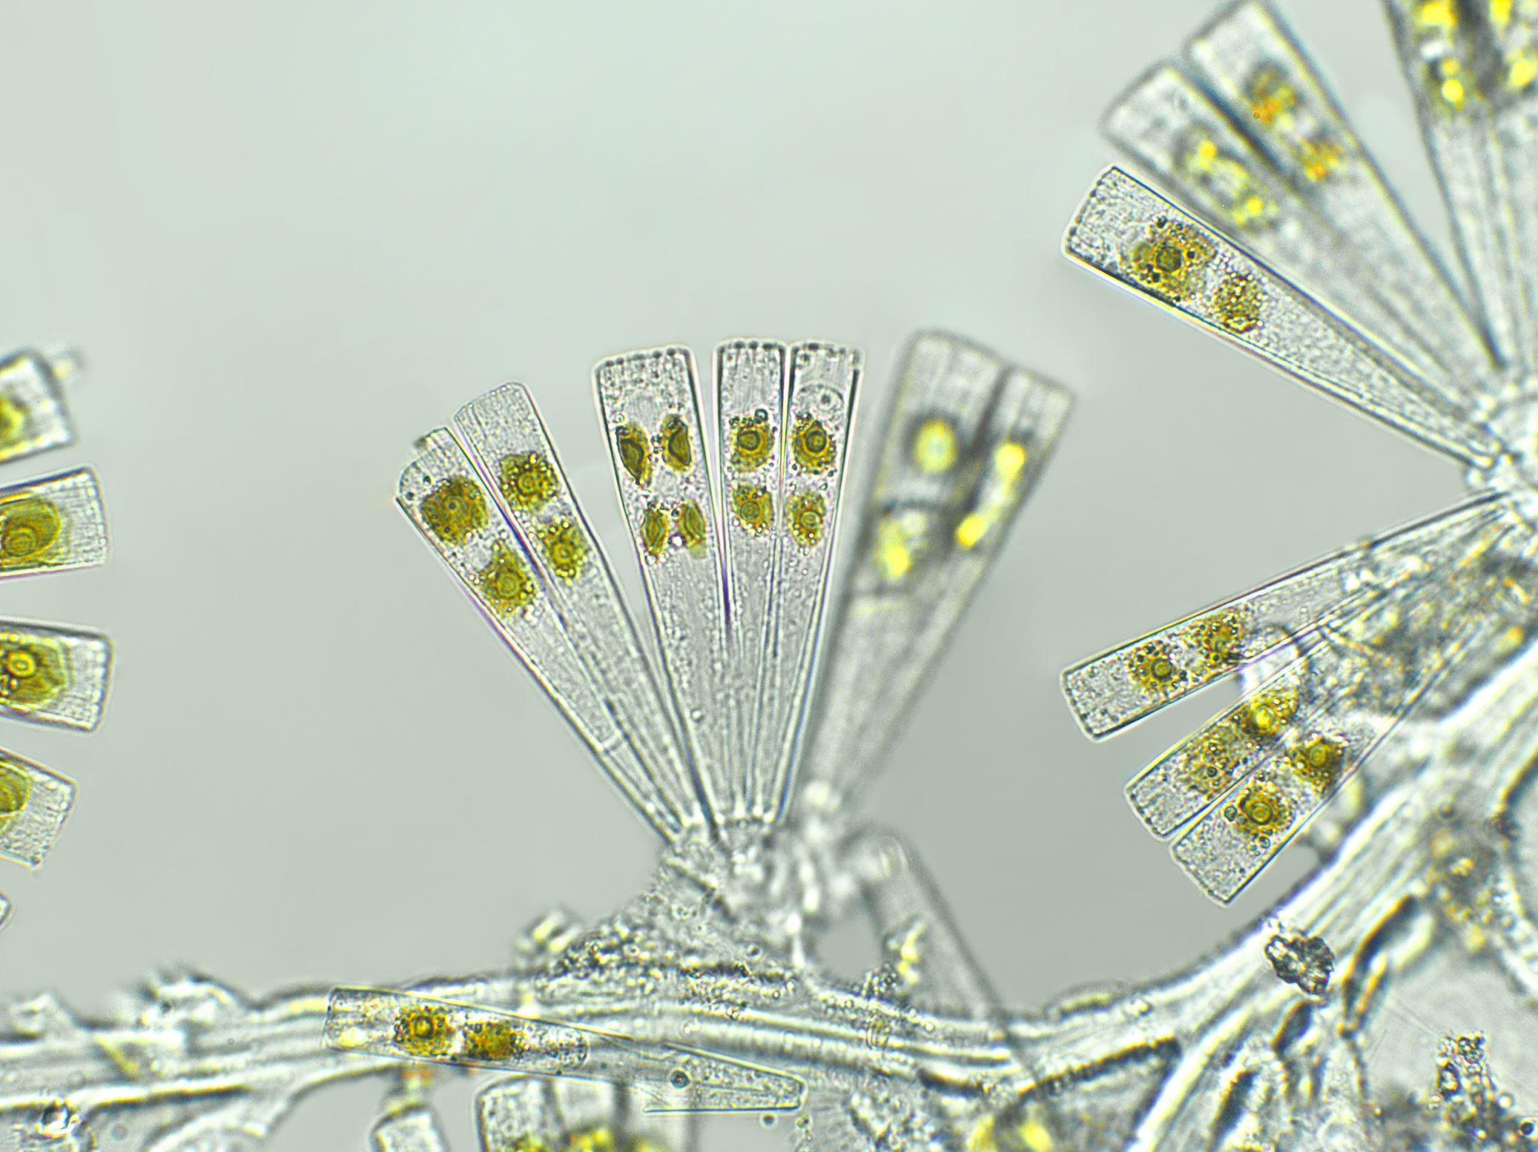
Contamination
& Bacteria
By Chanley Ferguson

Slide 2
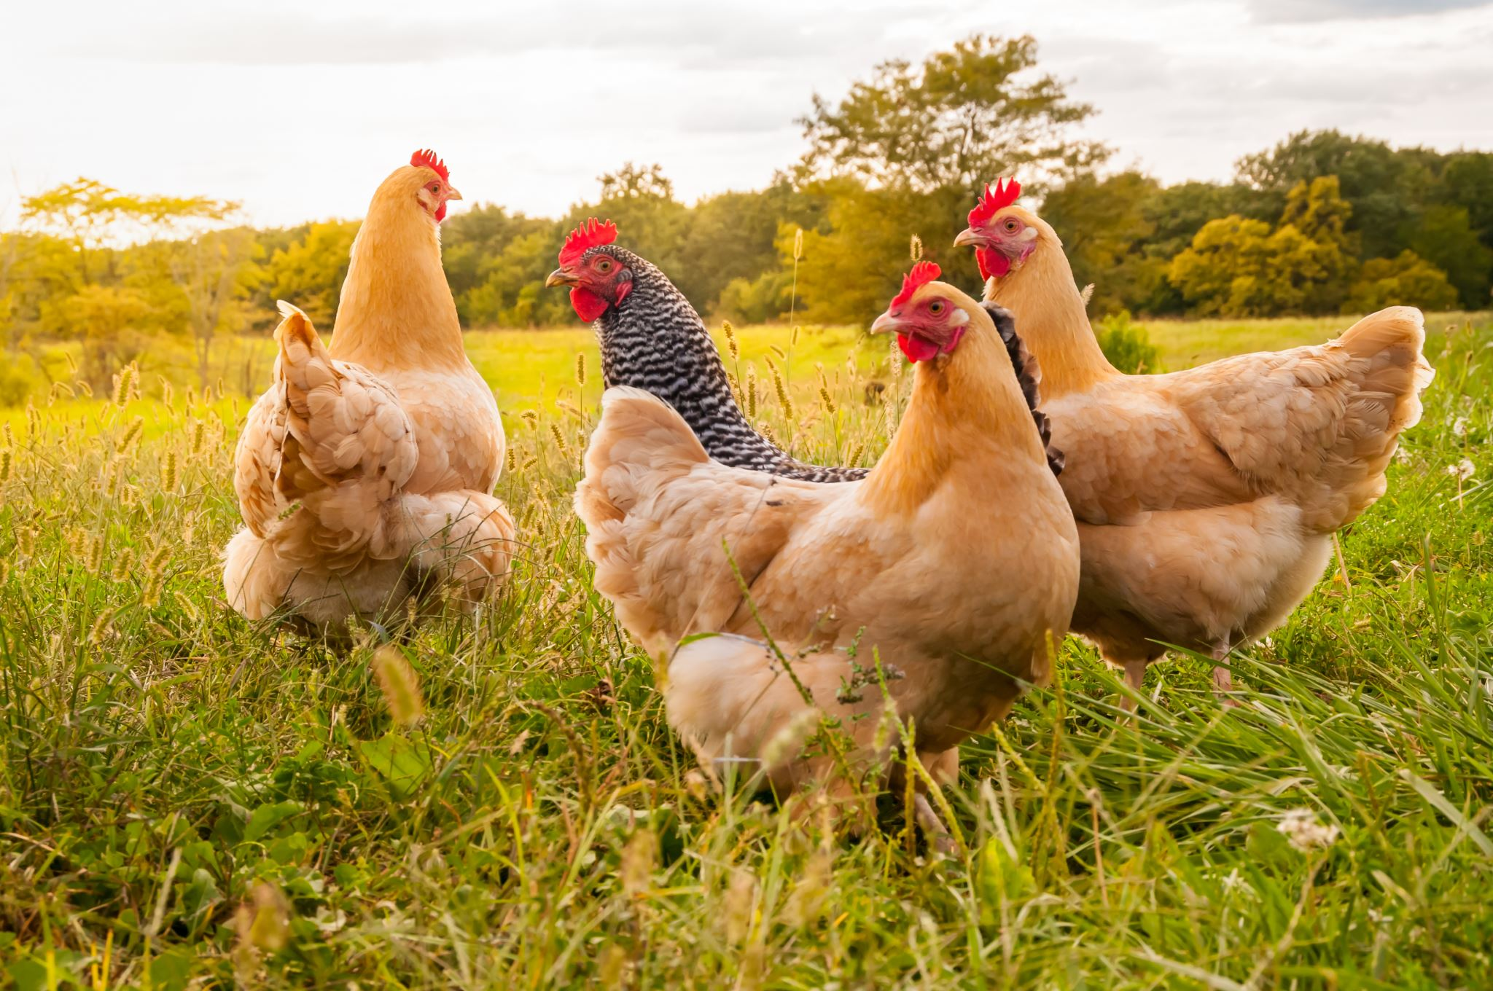


How does this happen?
Where Contaminants are Found
Animals
Air
Contaminated Water
Dirt
Chemicals

Slide 3
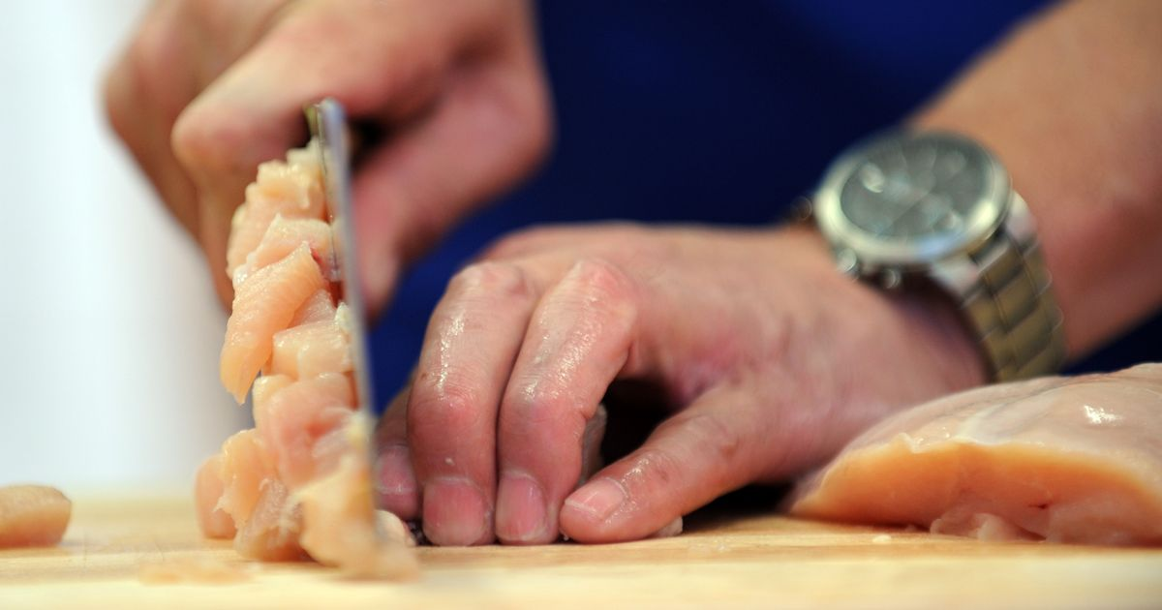
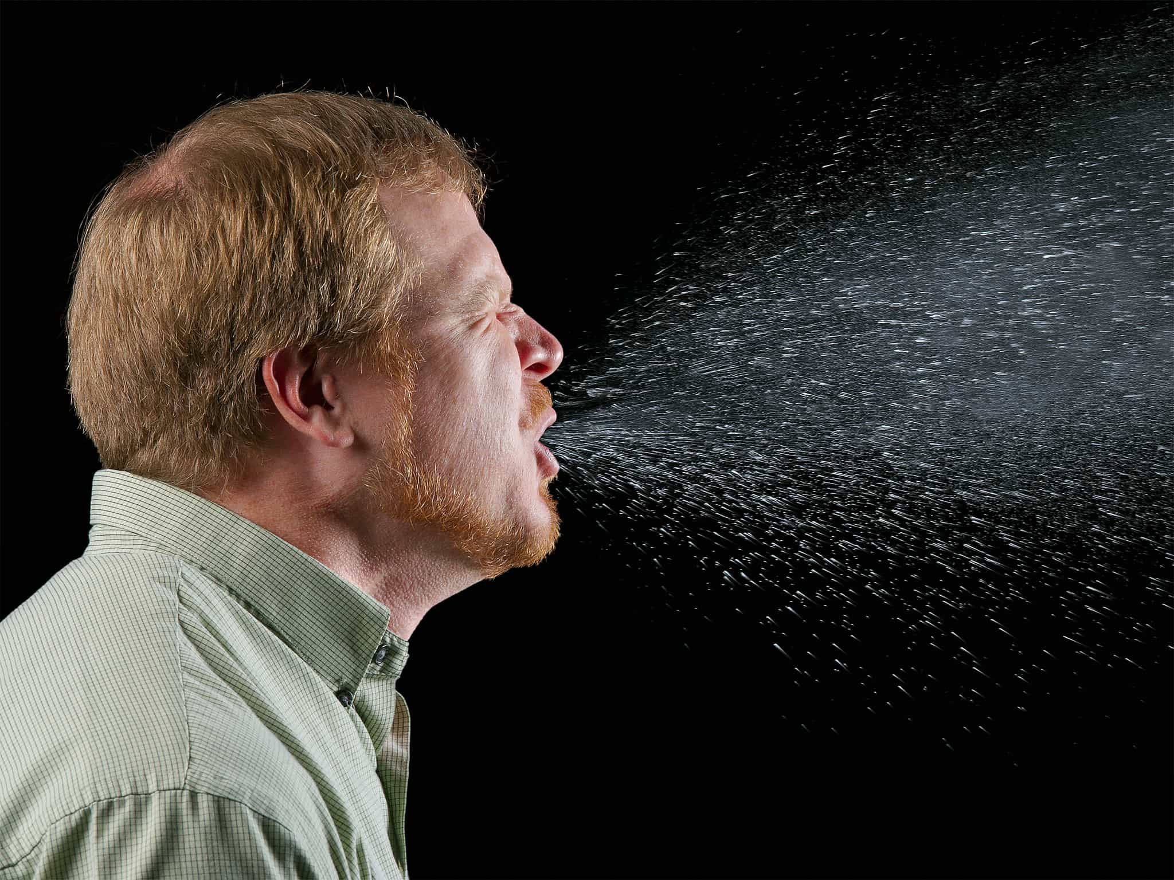
How does this happen?
How Contaminates are Passed On
Person to Person
Sneezing or vomiting onto food or food contact surfaces
Ready-to-eat foods touch surfaces that were in contact with raw meat
Fecal-Oral Route

Slide 4
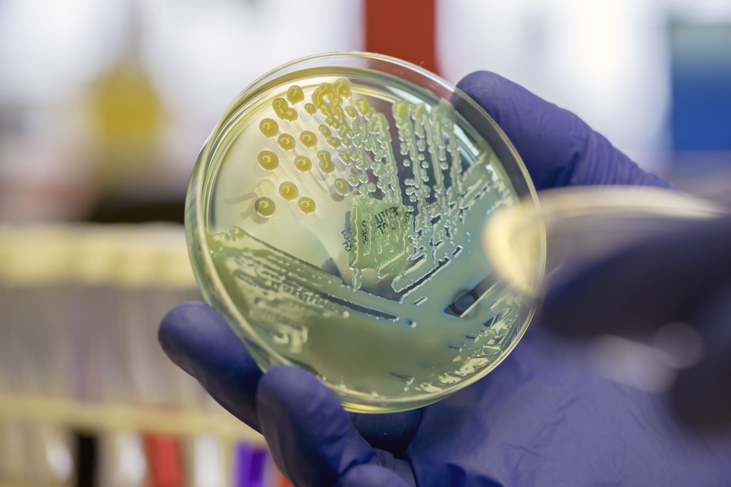
Pathogen: Bacteria
Basic Characteristics
Location
  Almost everywhere
  Healthy/Unhealthy
Detection
  Cannot be seen, smelled, or tasted
Growth
  Need 6 conditions to grow (FAT TOM)
Prevention
  Best way is to control Time and Temperature
Notes:
Bacteria is a type of pathogen which are harmful microorganisms. Some (like bacteria) make you sick when you eat them.

Slide 5







Bacterial Growth Conditions
Fat tom
Food
Acidity
Temperature
TCS Foods
pH 4-7
Temperature Danger Zone
Time
Oxygen
Moisture
More Time, More Opportunity
Some Need, Others Do Not
More Moisture, More Growth

Slide 6
Bacterial Growth Conditions
How to Control Them
Temperature
Time

Slide 7
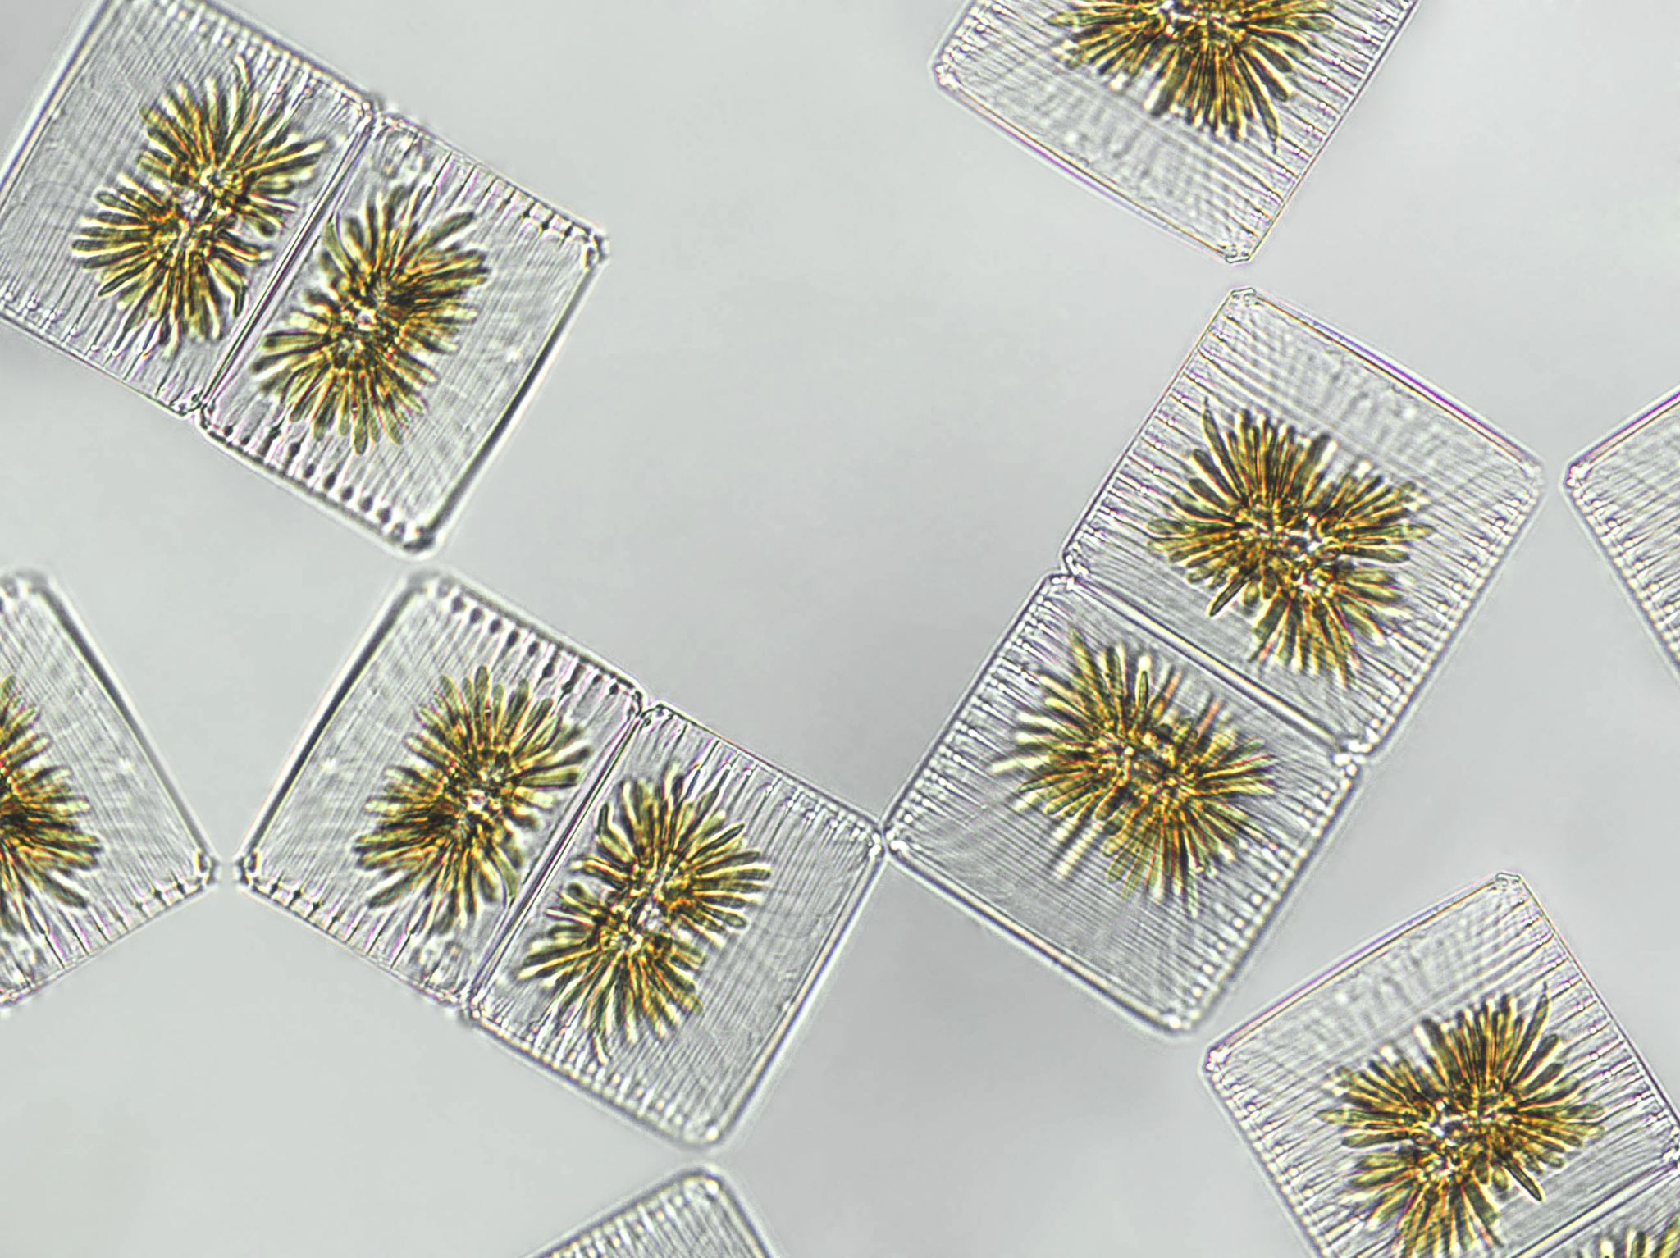
4 Major Bacteria That cause foodborne illnesses
Salmonella Typhi
Nontyphoidal Salmonella (NTS)
Shigella spp.
Shiga toxin-producing E. coli (STEC)

Slide 8
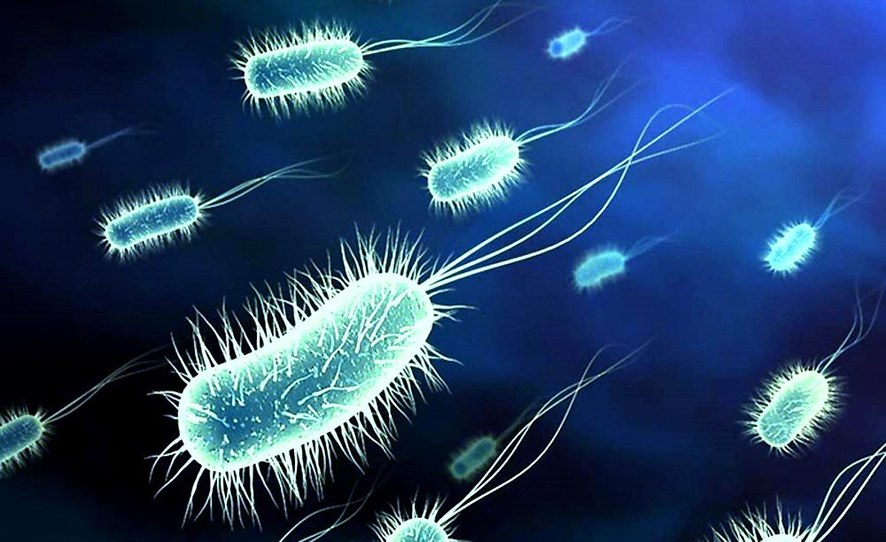
Salmonella Typhi
AKA Typhoid Fever
Source:
  Lives in Humans ONLY
  Is carried in the bloodstream and intestinal tract
Food Linked with Typhoid Fever:
  Ready-to-eat food
  Beverages
How to Prevent:
  Wash hands
  Cook food to correct internal temperatures
  Keep the infected away from food

Slide 9
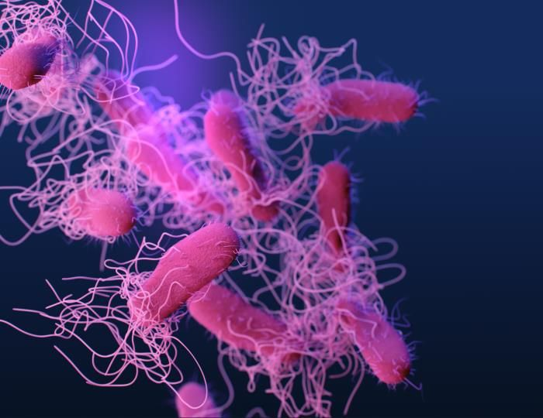
Nontyphoidal Salmonella (NTS)
AKA Salmonella
Source
  Farm animals
Food Linked with Salmonella
  Poultry & Eggs
  Meat
  Milk & Dairy
  Produce (Tomatoes, peppers, melons, etc.)
How to Prevent
  Cook meats and eggs to correct internal temperatures
  Stop cross-contamination
  Keep the infected away from food

Slide 10
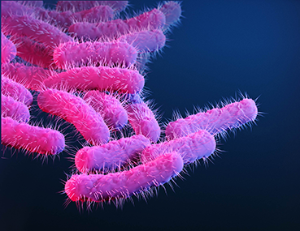
Shigella Spp.
AKA Shigellosis
Source
  Human feces (Food & Water)
  Flies
Food Linked with Shigellosis
  TCS food touched by hands
    Potato, tuna, shrimp, macaroni, etc.
  Food in contact with contaminated water
How to Prevent
  Wash hands
  Control flies
  Keep the infected away from food

Slide 11
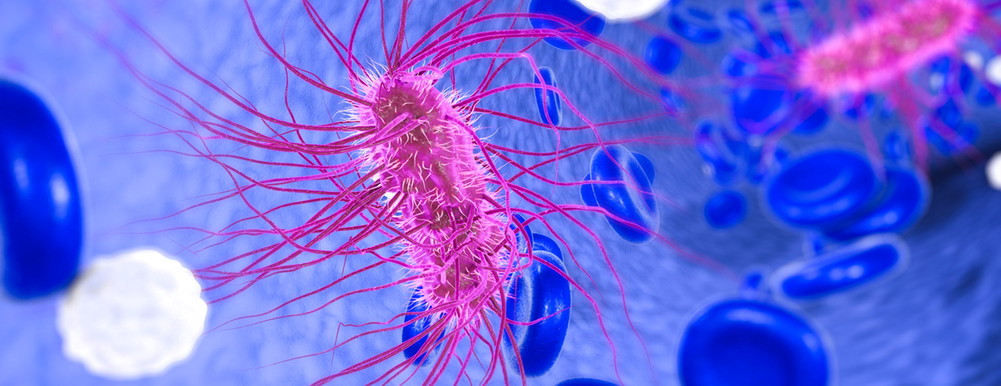
Shinga toxin-producing e. coli (stec)
Source
  Cattle intestine (contaminates meat)
  Infected people
Food Linked with E. Coli
  Ground Beef
  Contaminated produce
How to Prevent
  Cook food to correct internal temperatures
  Purchase from approved suppliers
  Prevent cross-contamination
  Keep the infected away from food

Slide 12





Symptoms
Diarrhea
Fever
Jaundice
Nausea
Vomiting
Varies depending on illness

Slide 13
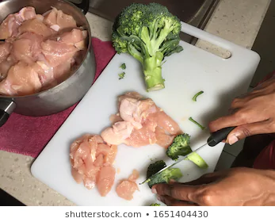
Class Activity: What's Wrong?
Ready-to-eat foods being chopped with raw meats

Slide 14

Class Activity: What's Wrong?
Sick while handling food

Slide 15
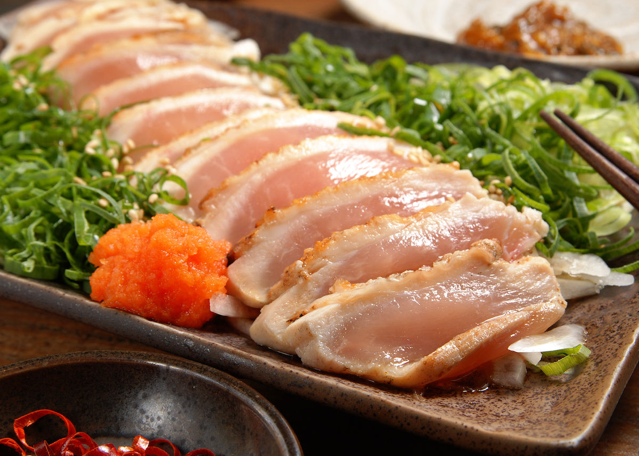
Class Activity: What's Wrong?
Meat is not cooked to proper internal temperature.

Slide 16
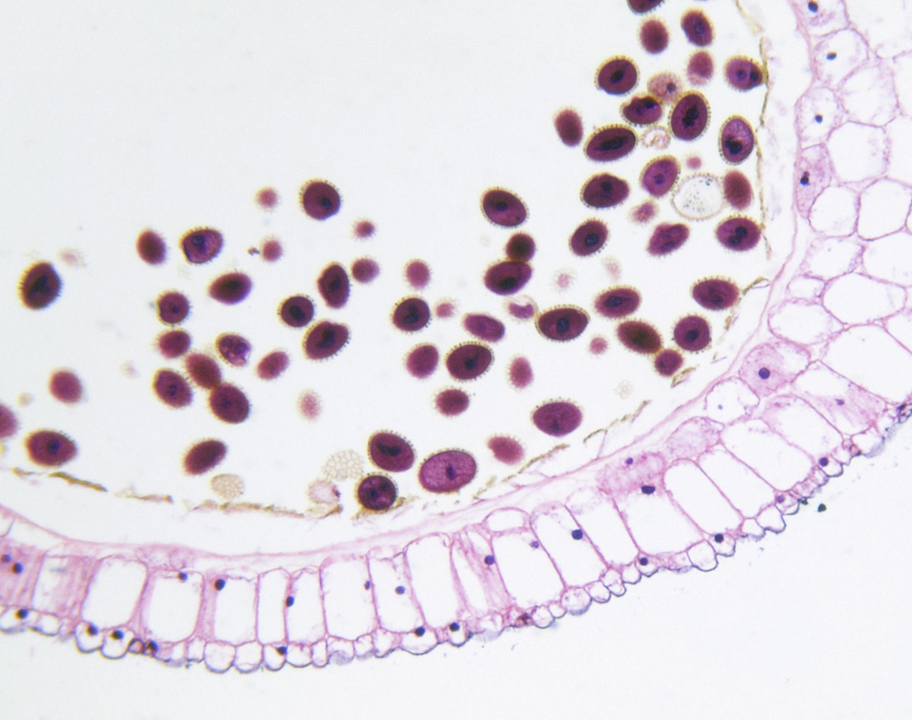
Thank you

